Slide 1
HISTORY OF FOOTBALL
CSE 3020 DATA VISUALISATION ARNAV SINGH 20 BCE 1731
ARCHIT AGARWAL 20 BCE 1773

Slide 2
INTRODUCTION
Football is a very famous sport across the globe which is beloved and watched by many. The first matches recorded date back to as far as 1872.
With the FIFA World Cup ending recently, we were inspired to visualize the data of various international football matches from 1872 all upto 2022.

Slide 3
ABSTRACT
Football has a lot of data to cover, from the individual to the team level. We can gain a better understanding of the game by using the data.
Furthermore, data can generate insights that lead to decision-making for teams. As a result, the team can develop strategies to win the game.
In our project, we visualize and show games played by various countries over the years, the goals scored , win rate and many different trends over the years.

Slide 4
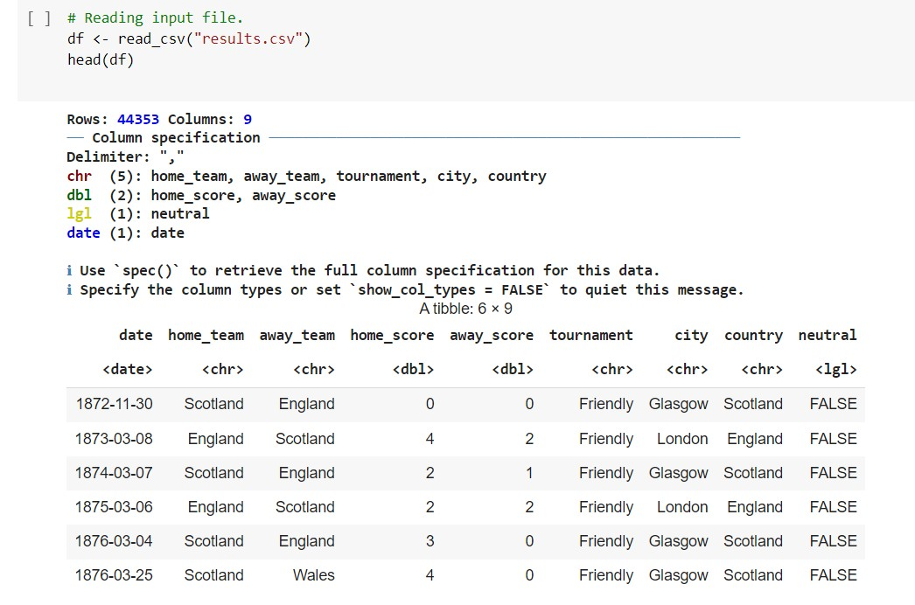
DATASET

Slide 5
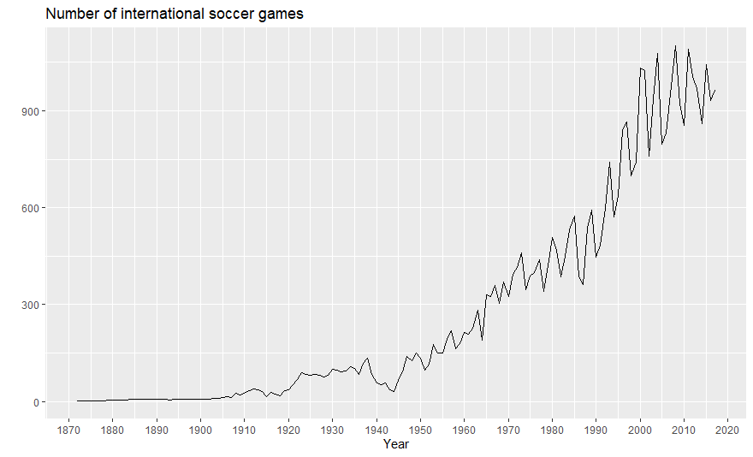
IMPLEMENTATION
THE GRAPH SHOWS NO OF GAMES WERE
PLAYED EACH YEAR AND HOW THE TOTAL NUMBER OF
INTERNATIONAL
GAMES EVOLVE WITH TIME.

Slide 6
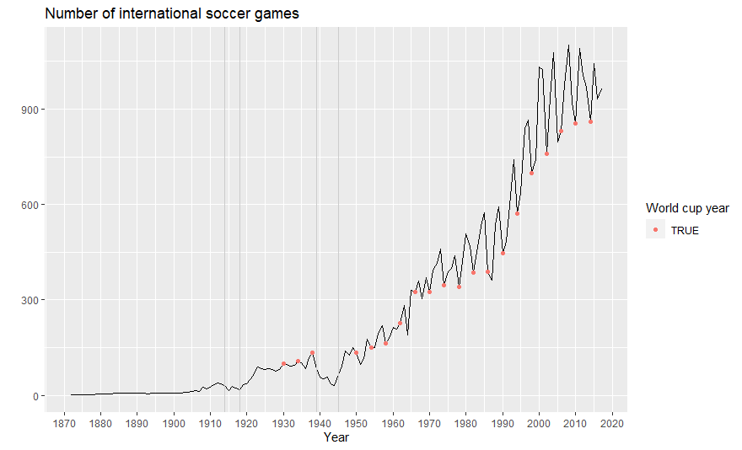
IMPLEMENTATION
THE GRAPH SHOWS NO OF WORLD CUP GAMES PLAYED EACH YEAR
AND HOW THE TOTAL NUMBER OF WORLD CUP GAMES EVOLVE
WITH TIME.

Slide 7
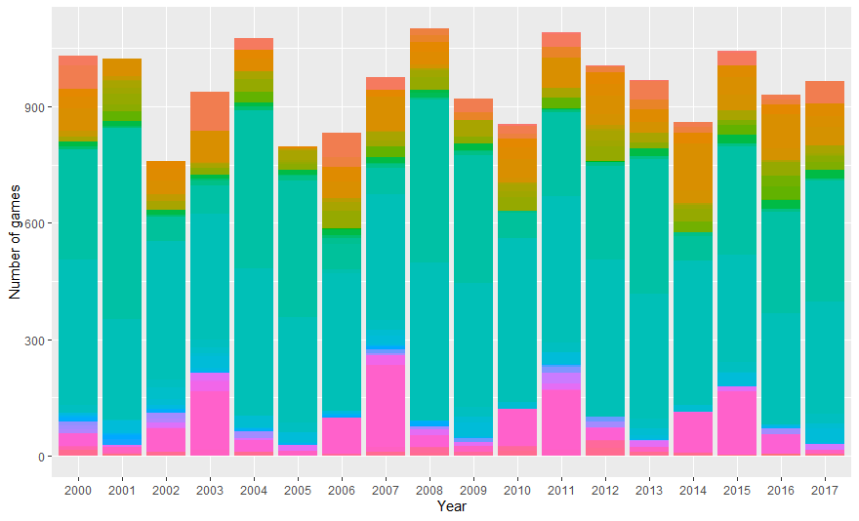
IMPLEMENTATION
WE CAN SEE THAT SOME
EVENTS/TOURNAMENT S ARE MORE FREQUENT ON NON- WORLD CUP
YEARS SUCH AS 2007 OR 2011 . LET' S CHECK WHAT THEY ARE.

Slide 8
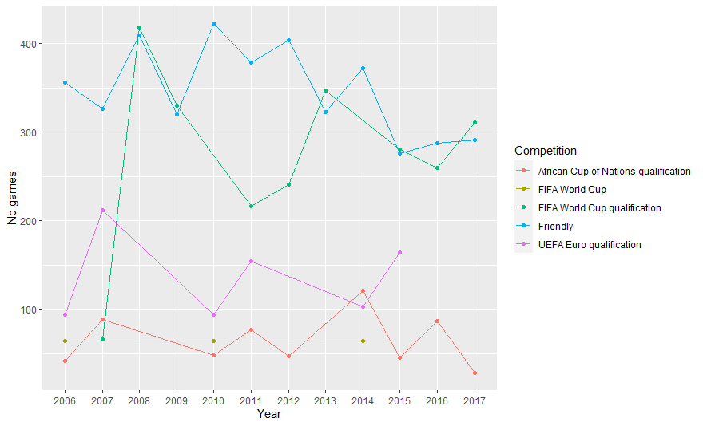
IMPLEMENTATION
WORLD CUP
QUALIFICATIONS GENERATES MUCH
MORE MATCHES THAN THE WORLD CUP
ITSELF, WHICH MAKES SENSE AS THE WORLD CUP ONLY CONCERNS 32 COUNTRIES.

Slide 9
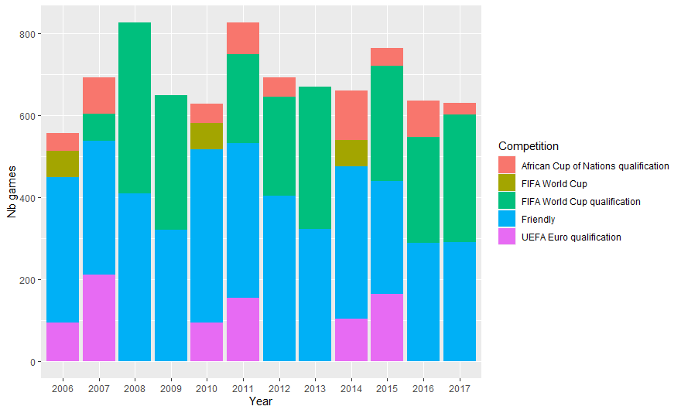
IMPLEMENTATION
NON WORLD CUP EVENTS BAR PLOT

Slide 10
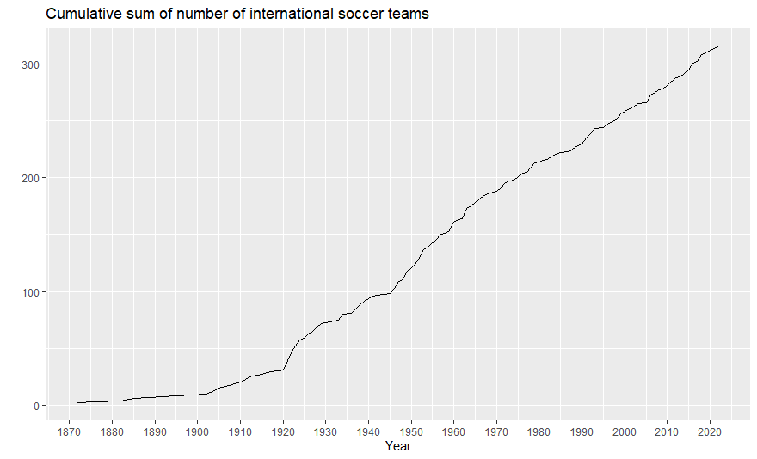
IMPLEMENTATION
THE GRAPH SHOWS CUMULATIVE SUM OF NO OF INTERNATIONAL
SOCCER TEAMS

Slide 11
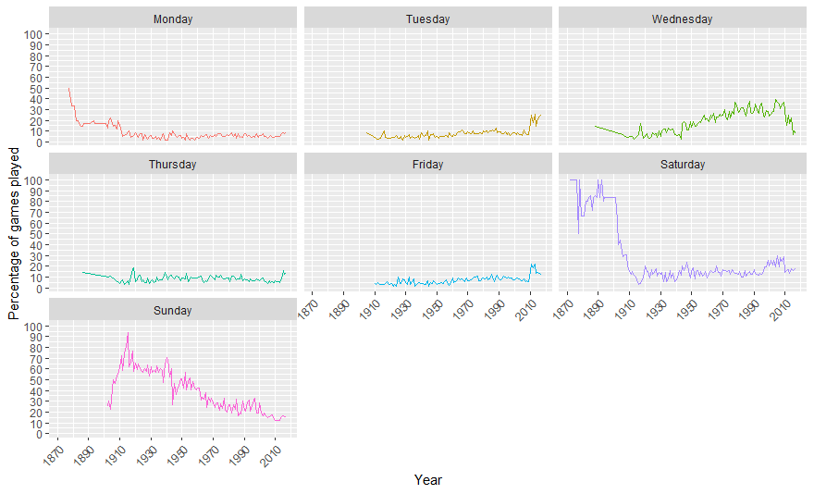
IMPLEMENTATION
THE GRAPH SHOWS THE COMPARISON
BETWEEN THE DAYS ON THE BASIS OF NO OF
SOCCER GAMES PLAYED

Slide 12
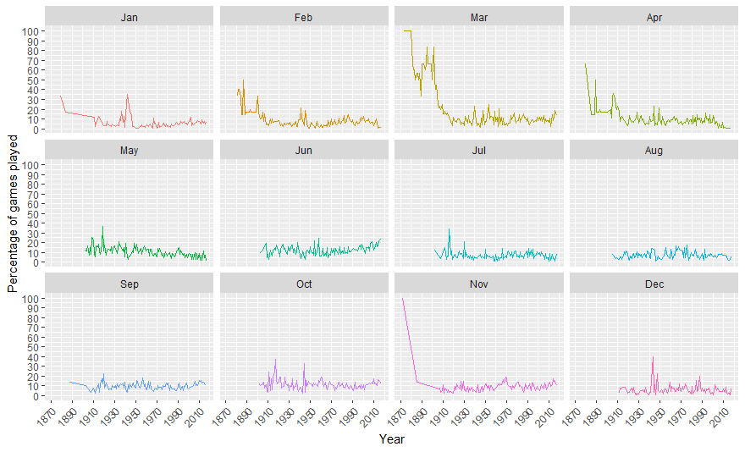
IMPLEMENTATION
THE GRAPH SHOWS THE COMPARISON
BETWEEN THE MONTHS ON THE BASIS OF NO OF SOCCER GAMES
PLAYED

Slide 13
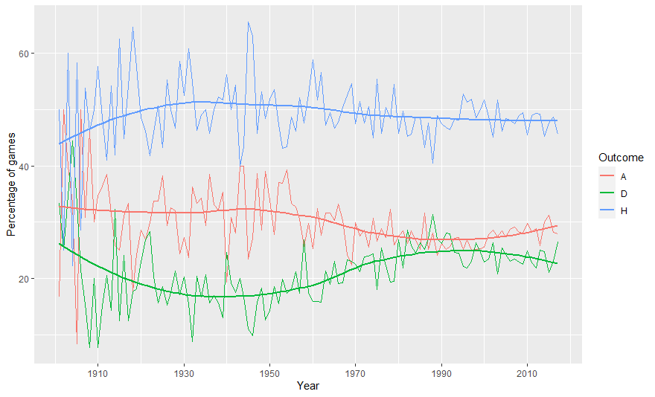
IMPLEMENTATION
THE GRAPH SHOWS THE PERCENTAGE OF GAMES A D H

Slide 14
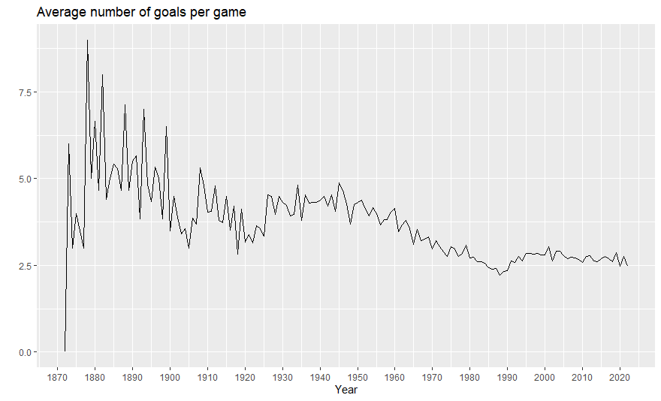
IMPLEMENTATION
THE GRAPH SHOWS AVERAGE NUMBER OF
GOALS PER GAME

Slide 15
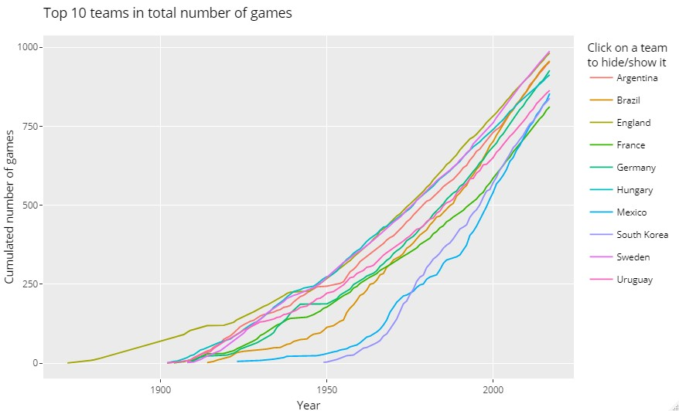
IMPLEMENTATION
THE GRAPH SHOWS TOP TEN INTERACTIVE
WINNING TEAMS

Slide 16
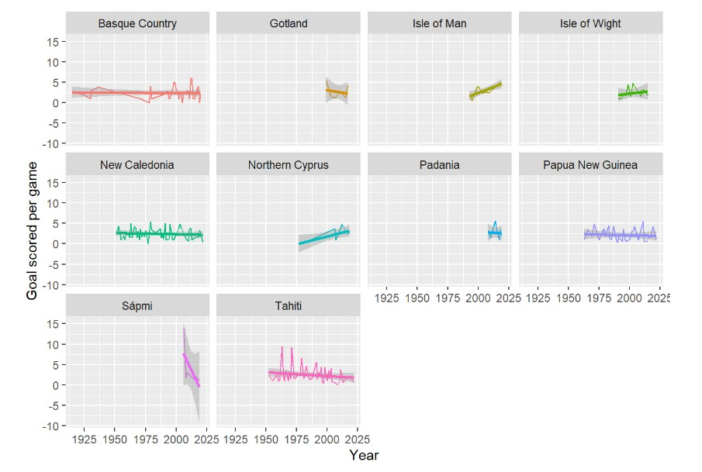
IMPLEMENTATION
THE GRAPH SHOWS NUMBER OF GOALS SCORED PER GAME

Slide 17
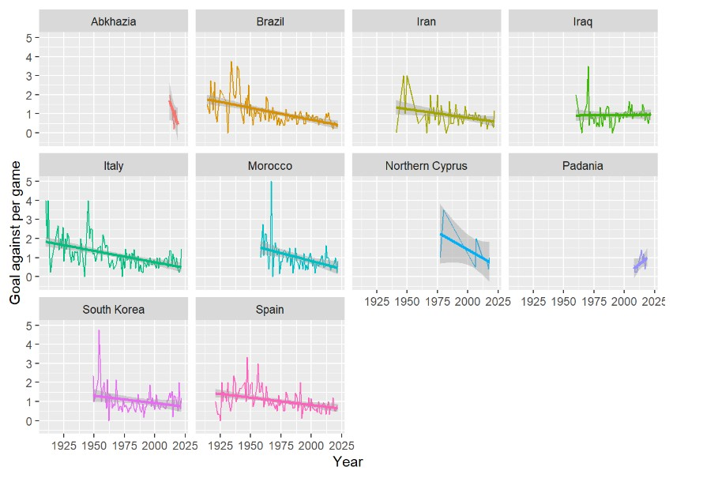
IMPLEMENTATION
THE GRAPH SHOWS NUMBER OF GRAPHS AGAINST PER GAME

Slide 18
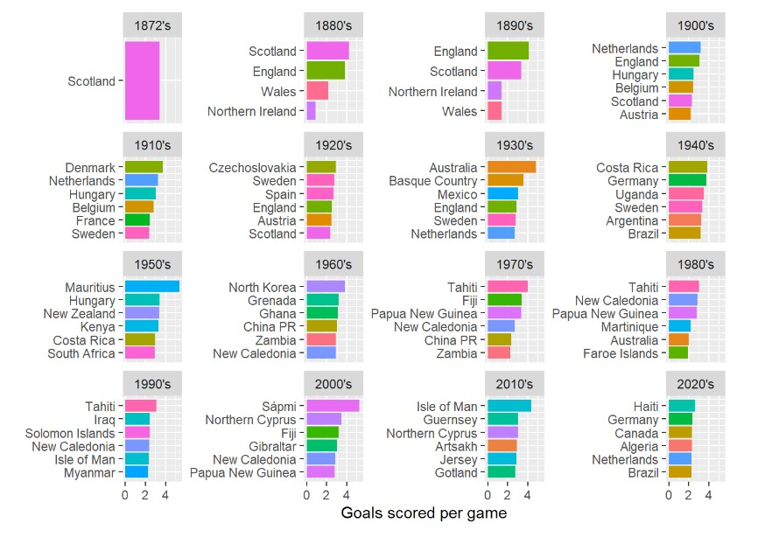
IMPLEMENTATION
THE GRAPH SHOWS NUMBER OF GOALS SCORED PER GAME

Slide 19
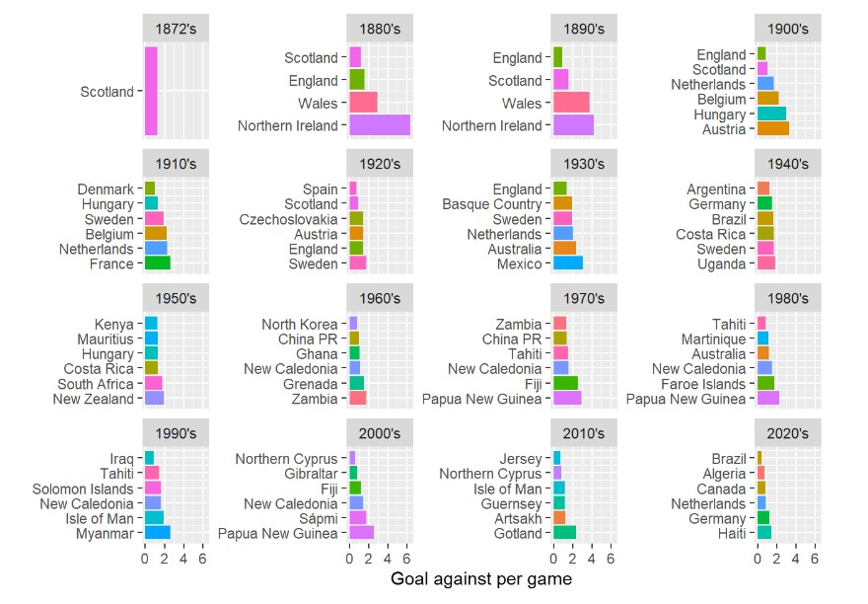
IMPLEMENTATION
THE GRAPH SHOWS NUMBER OF GOALS AGAINST PER GAME

Slide 20
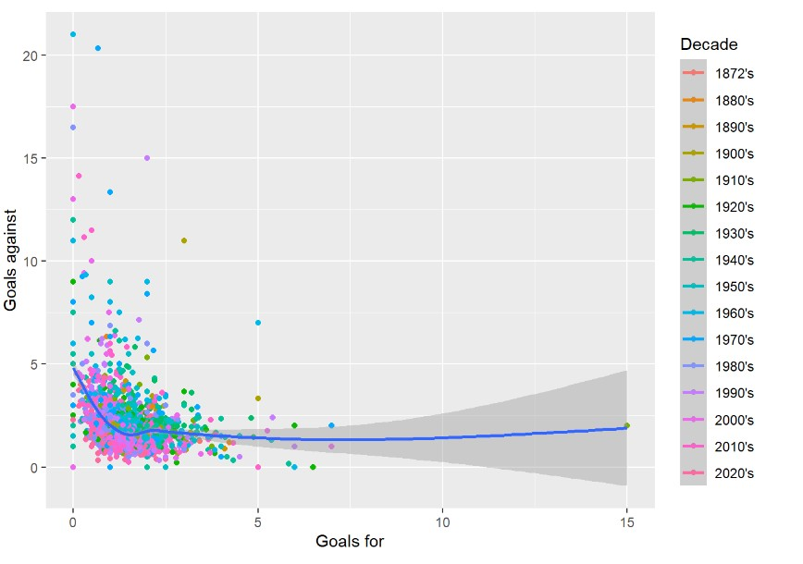
IMPLEMENTATION
GOALS FOR VS GOALS AGAINST GRAPH

Slide 21
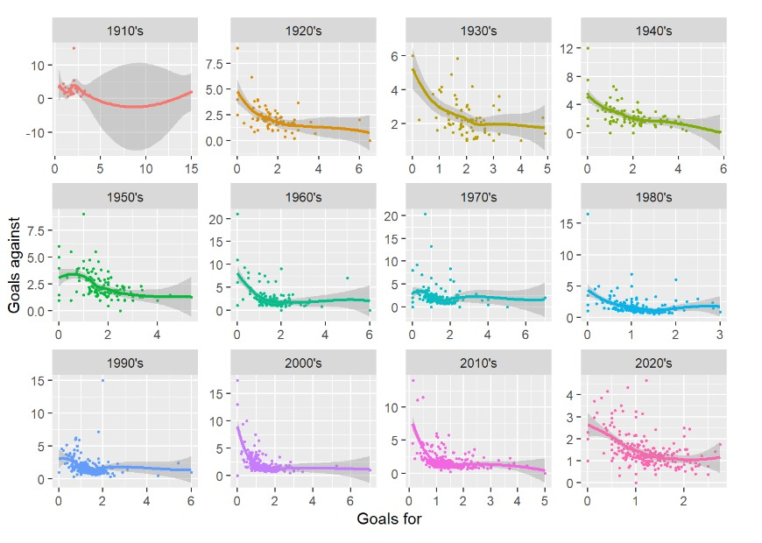
IMPLEMENTATION
GOALS FOR VS GOALS AGAINST GRAPH

Slide 22
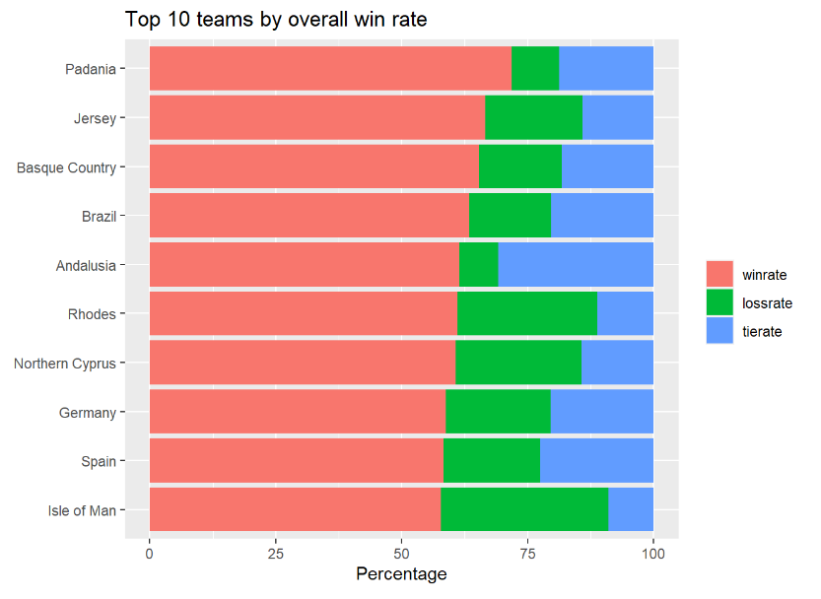
IMPLEMENTATION
GRAPH SHOWS TOP 10 TEAMS BY OVERALL
WIN RATE

Slide 23
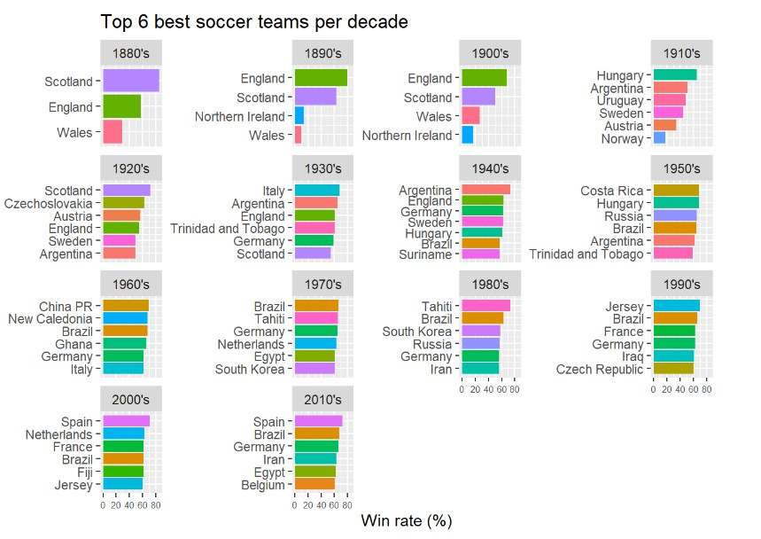
IMPLEMENTATION
GRAPH SHOWS TOP 6 BEST SOCCER TEAMS PER DECADE

Slide 24
THANK YOU!

